Slide 1

Authentication Mechanisms for Wireless and Mobile Networks
Network and autonomous systems security
Supervisor : Lyes khoukhi
Students : Mustapha HANDAG
SEBIHI Ahmed Nidhar
Mohamed Toufik
KASDI Sarah

Slide 2
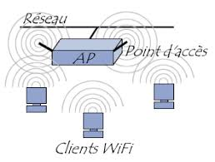
Introduction
Authentication in wireless and mobile networks is a crucial process that verifies the identity of users or devices attempting to access the network. Its primary goal is to ensure that only authorized users or devices can connect, thereby preventing unauthorized access that could compromise data and network security. In the context of wireless and mobile networks, security challenges are greater than in wired networks, as signals are broadcast through the air, making them more vulnerable to interception and attacks.
Notes:
L'authentification dans les réseaux sans fil et mobiles est essentielle pour vérifier l'identité des utilisateurs ou appareils et assurer que seuls les autorisés accèdent au réseau. Cela renforce la sécurité face aux risques accrus, car les signaux diffusés dans l’espace sont plus vulnérables aux interceptions et attaques que dans les réseaux filaires.

Slide 3
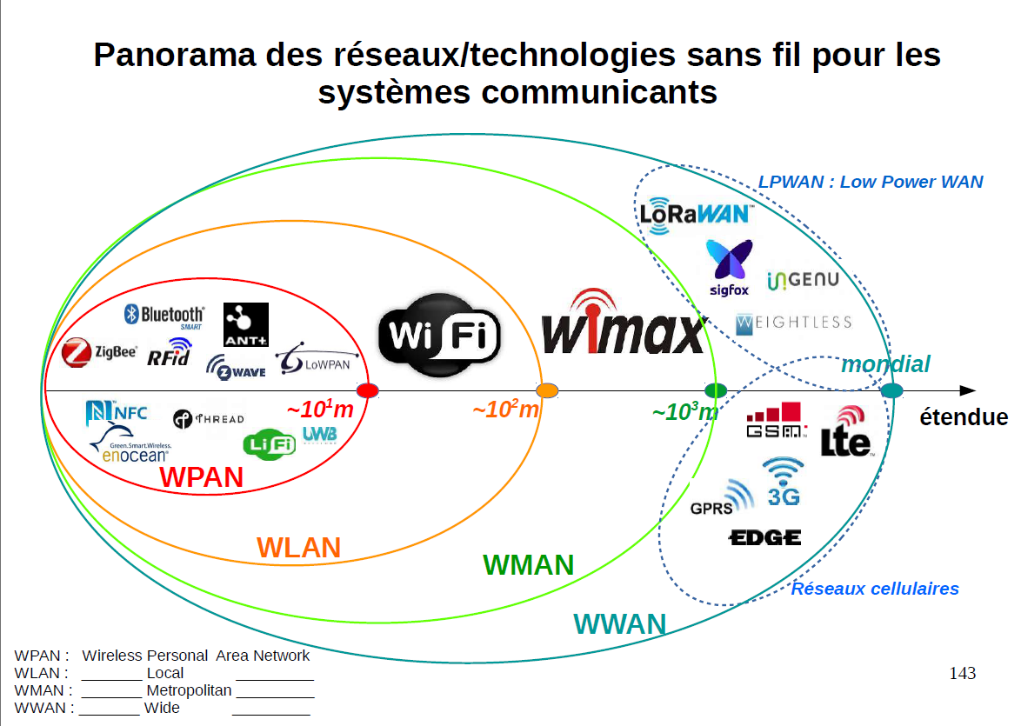
Wireless and mobile networks
Wireless and mobile networks are communication systems that enable data transmission without the use of physical cables. While they share certain similarities, they differ in terms of technology, coverage, and application types.
[1]
Notes:
Cette image présente un panorama des différentes technologies sans fil utilisées, classées selon leur portée. On distingue quatre catégories principales :
1 - WPAN (Wireless Personal Area Network) : Ce sont des réseaux personnels à courte portée, typiquement quelques mètres, comme le Bluetooth, ZigBee, ou NFC. Ils connectent des appareils proches, souvent pour des échanges rapides ou des applications domotiques.
2 - WLAN (Wireless Local Area Network) : Ici, on trouve le Wi-Fi, utilisé pour les réseaux locaux, généralement à l'échelle d'un bâtiment ou d'une maison, avec une portée d'environ 100 mètres.
3 - WMAN (Wireless Metropolitan Area Network) : Ce type de réseau, comme le WiMAX, couvre des zones métropolitaines ou des villes entières, avec une portée allant jusqu’à plusieurs kilomètres.
4 - WWAN (Wireless Wide Area Network) : Il s'agit des réseaux à très large portée, comme les technologies cellulaires (3G, 4G, LTE) et les réseaux LPWAN (LoRaWAN, Sigfox), qui permettent des connexions sur des distances de plusieurs kilomètres, voire mondiales.
Chaque technologie est adaptée à des besoins spécifiques en termes de portée, consommation énergétique et débit.

Slide 4
Types of Wireless Networks
Wireless networks encompass various technologies that enable devices to communicate wirelessly within a defined area, using radio waves.
Wi-Fi: Wi-Fi is a type of wireless local area network (WLAN) that allows devices to connect within a limited range, such as in a home, office, or cafe.
Technology: It uses IEEE 802.11 standards, including versions such as 802.11n, 802.11ac, and 802.11ax (Wi-Fi 6). These standards govern frequencies (2.4 GHz and 5 GHz), bandwidth, and encryption methods.
Applications: Primarily used to connect devices such as computers, phones, tablets, and IoT devices within local areas.
Range and Speed: The range can vary from 30 to 100 meters depending on obstacles, with maximum speeds reaching several Gbps (especially with Wi-Fi 6). Examples: Airports, homes, or university campuses.
Notes:
Le Wi-Fi est un réseau local sans fil (WLAN) qui connecte des appareils sur un périmètre limité, comme une maison ou un bureau. Basé sur les normes IEEE 802.11 (comme 802.11ac ou Wi-Fi 6), il utilise les fréquences 2,4 GHz et 5 GHz pour offrir une portée de 30 à 100 mètres et un débit pouvant atteindre plusieurs Gbps.

Slide 5
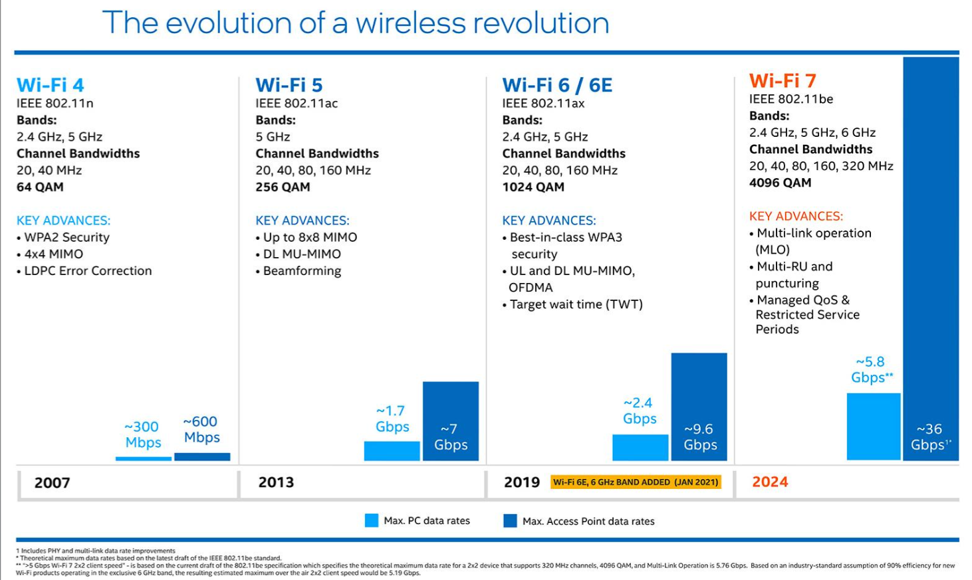
[2]

Slide 6
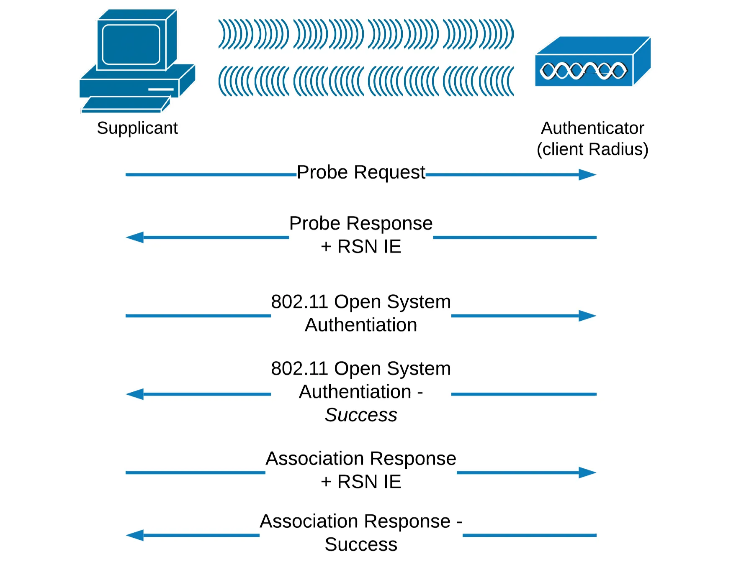
Typical Connection Process
The client broadcasts a request to scan for networks in the vicinity.
Access points within the area respond to the request.
The client selects an access point and sends an authentication request.
The access point replies with an authentication response.
Once authentication is successful, the client sends an association request to the access point.
The access point responds to the association request.
If all the previous steps are successful, the client can now use the access point to access the Internet.
[3]
Notes:
Le client diffuse une requête pour sonder les réseaux présents dans le voisinage.
Les points d'accès présents dans la zone répondent.
Le client décide quel point d'accès utiliser et envoie une demande d'authentification.
Le point d'accès renvoie une réponse pour l'authentification.
Une fois l'authentification réussie, le client envoie une demande d'association avec le point d'accès.
Le point d'accès répond à cette demande d'association.
Le client peut maintenant utiliser le point d'accès pour accéder à Internet si toutes les étapes précédentes ont réussi.

Slide 7
Mobile Networks
Mobile networks, also known as cellular networks, enable devices to connect over large geographic areas, often spanning cities, countries, or even continents. Unlike local wireless networks like Wi-Fi, mobile networks rely on cellular towers to provide coverage across vast distances.
2G (GSM, CDMA): Launched in the 1990s, 2G was the first generation of digital networks, used primarily for voice calls and SMS. It offered very low speeds, around 64 kbps.
3G (UMTS, CDMA2000): Introduced in the 2000s, 3G allowed the transfer of small amounts of data, enabling basic web browsing and app downloads. Speeds reached up to 2 Mbps.
4G (LTE, LTE-Advanced): The advent of 4G brought download speeds of up to 1 Gbps, enabling HD video streaming, online gaming, and video calls.
5G: The latest generation of mobile networks offers theoretical speeds of up to 10 Gbps with extremely low latency. It supports advanced applications such as augmented reality, connected cars, and dense IoT networks.
Notes:
2G (GSM, CDMA) : Lancée dans les années 90, la 2G est la première génération de réseaux numériques, utilisée pour les appels et les SMS. Elle offre des vitesses très faibles, autour de 64 kbps.
3G (UMTS, CDMA2000) : Introduite dans les années 2000, elle permettait de transférer de petites quantités de données, permettant la navigation sur Internet et le téléchargement d'applications. Les débits allaient jusqu'à 2 Mbps.
4G (LTE, LTE-Advanced) : Avec l'avènement de la 4G, les débits ont atteint jusqu'à 1 Gbps en téléchargement, rendant possible le streaming vidéo HD, les jeux en ligne et les appels vidéo.
5G : La dernière génération de réseaux mobiles, elle offre des vitesses théoriques jusqu'à 10 Gbps, avec une latence extrêmement faible. Elle permet des applications avancées comme la réalité augmentée, les voitures connectées, et des réseaux denses d'objets connectés (IoT).

Slide 8
Mobile Network Technologies
Features | 1G | 2G | 3G | 4G | 5G | 6G
Technologie | AMPS,NMT,TACS | GSM | WCDMA | LTE, WiMAX | MIMO, mm Waves
Frequency | 30 KHz | 1,8 GHz | 1,6 – 2 GHz | 2 – 8 GHz | 3 - 30GHz | THz band (TeraHertz)
Bandwidth | 2kbps | 14,4 – 64 Kbps | 2Mbps | 2000 Mbps to 1Gbps | >= 1 Gbps | >100 Gbps
Access System | FDMA | TDMA CDMA | CDMA | CDMA | OFDM BDMA | Under Construction
Core Network | PSTN | PSTN | Packet Network | Internet | Internet
[4]

Slide 9
What are WEP, WPA, WPA2, and WPA3
WEP, or Wired Equivalent Privacy, is the oldest and most vulnerable wireless security protocol. On the other hand, Wi-Fi Protected Access (WPA) and its subsequent versions, WPA2 and WPA3, provide superior security features. WPA3 is the most advanced protocol, offering robust encryption and enhanced security improvements.
WEP (Wired Equivalent Privacy) is a protocol based on 128-bit encryption. It is strongly discouraged due to its significant vulnerabilities in terms of security.
WPA (WiFi Protected Access) is a more recent security protocol that provides enhanced protection through the using of a shared key, known as a PSK (Pre-Shared Key).
WPA2 is the most widely used version of WPA, offering stronger security than WPA.
WPA3 replaces the WPA2 Pre-Shared Key (PSK) with Simultaneous Authentication of Equals (SAE) to prevent key reinstallation attacks, such as the notorious KRACK attack.

Slide 10
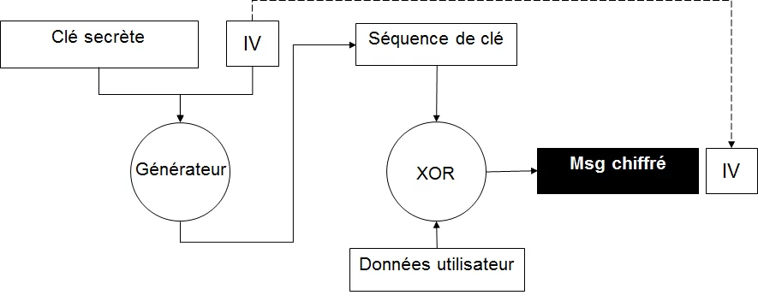
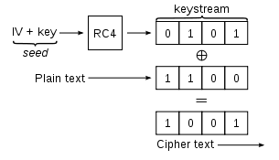
WEP (Wired Equivalent Privacy)
WEP encryption is a protocol responsible for the encryption of frames and uses the symmetric algorithm RC4.
The secret key has a length of 40 or 104 bits.
It assumes that the client and the server share a common secret key.
Additionally, it incorporates 24 bits of IV (which is why WEP keys are often configured as 40+24=64 bits or 104+24=128 bits).
[5]

Slide 11
WPA (Wi-Fi Protected Access)
Encryption Protocol: Uses TKIP (Temporal Key Integrity Protocol).
Key Features of TKIP :
Per-packet mixing function.
Message integrity check to prevent tampering.
Extended initialization vector (IV) for better security.
Key re-coding (re-keying) mechanism to enhance protection.
User Authentication: Ensures robust authentication based on the 802.1x standard.
[6]
Notes:
WPA (Wi-Fi Protected Access) : protocole d'authentication developpe par la Wi-Fi Alliance pour remedier aux faiblesses
de WEP et servir d'intermediaire avant WPA2.
- Concu pour fonctionner avec le meme materiel que WEP mais avec un logiciel mis a jour.
Utilise RC4 avec une clé de 128 bits + 48 bits pour le vecteur d'initialisation.
Implemente le protocole TKIP pour contrer certaines faiblesses rencontrees par WEP.
La méthode de chiffrement WPA fait appel au protocole TKIP (Temporal Key Integrity Protocol). TKIP comprend une fonction de mélange « par paquet », un contrôle d'intégrité du message, un vecteur d'initialisation étendu et un mécanisme de recodage (re-keying). La norme WPA assure une authentification utilisateur robuste fondée sur le standard 802.1x et le protocole EAP (Extensible Authentication Protocol). Pour authentifier l'utilisateur, cette norme s'appuie sur un serveur d'authentification centralisé, tel que RADIUS.

Slide 12
Main Characteristics of WPA2
Encryption Standard: Uses AES (Advanced Encryption Standard), a government-approved cryptographic module.
Enhanced Security: AES provides stronger and more complex encryption compared to TKIP used in WPA.
Pre-Shared Key Mode:
Includes WPA2-PSK, which simplifies configuration for home users.
Offers a high level of security while being user-friendly.
Improved Security Features: Designed to strengthen wireless network protection with advanced encryption mechanisms.
[7]
Notes:
WPA2 introduit plusieurs fonctionnalités de sécurité avancées et normes de cryptage qui renforcent la protection des réseaux sans fil. Il utilise l'Advanced Encryption Standard (AES), un module cryptographique approuvé par le gouvernement, qui est plus sécurisé et plus complexe que le Temporal Key Integrity Protocol (TKIP) utilisé dans WPA. WPA2 comprend également un mode de clé pré-partagée (PSK), connu sous le nom de WPA2-PSK, qui simplifie la configuration pour les utilisateurs particuliers tout en offrant un haut niveau de sécurité.

Slide 13
WPA 3
Improved Authentication: Introduces Simultaneous Authentication of Equals (SAE), replacing the Pre-Shared Key (PSK) method used in WPA2.
Provides greater resilience against offline dictionary attacks.
Enhanced Security Suite:
Includes a 192-bit security suite aligned with the CNSA (Commercial National Security Algorithm).
Offers higher protection for networks handling sensitive data.
Advanced Protection: Delivers significant upgrades in encryption and overall security compared to WPA2. [7]
Notes:
WPA3 introduit plusieurs améliorations de sécurité clés par rapport à WPA2. Le plus notable d'entre eux est l'authentification simultanée des égaux (SAE), qui remplace la méthode Pre-Shared Key (PSK) utilisée dans WPA2, la rendant plus résiliente contre les attaques par dictionnaire hors ligne. Une autre amélioration significative est l'introduction d'une suite de sécurité 192 bits alignée sur la suite CNSA (Commercial National Security Algorithm), qui offre un niveau de protection plus élevé pour les réseaux transmettant des données sensibles.

Slide 14
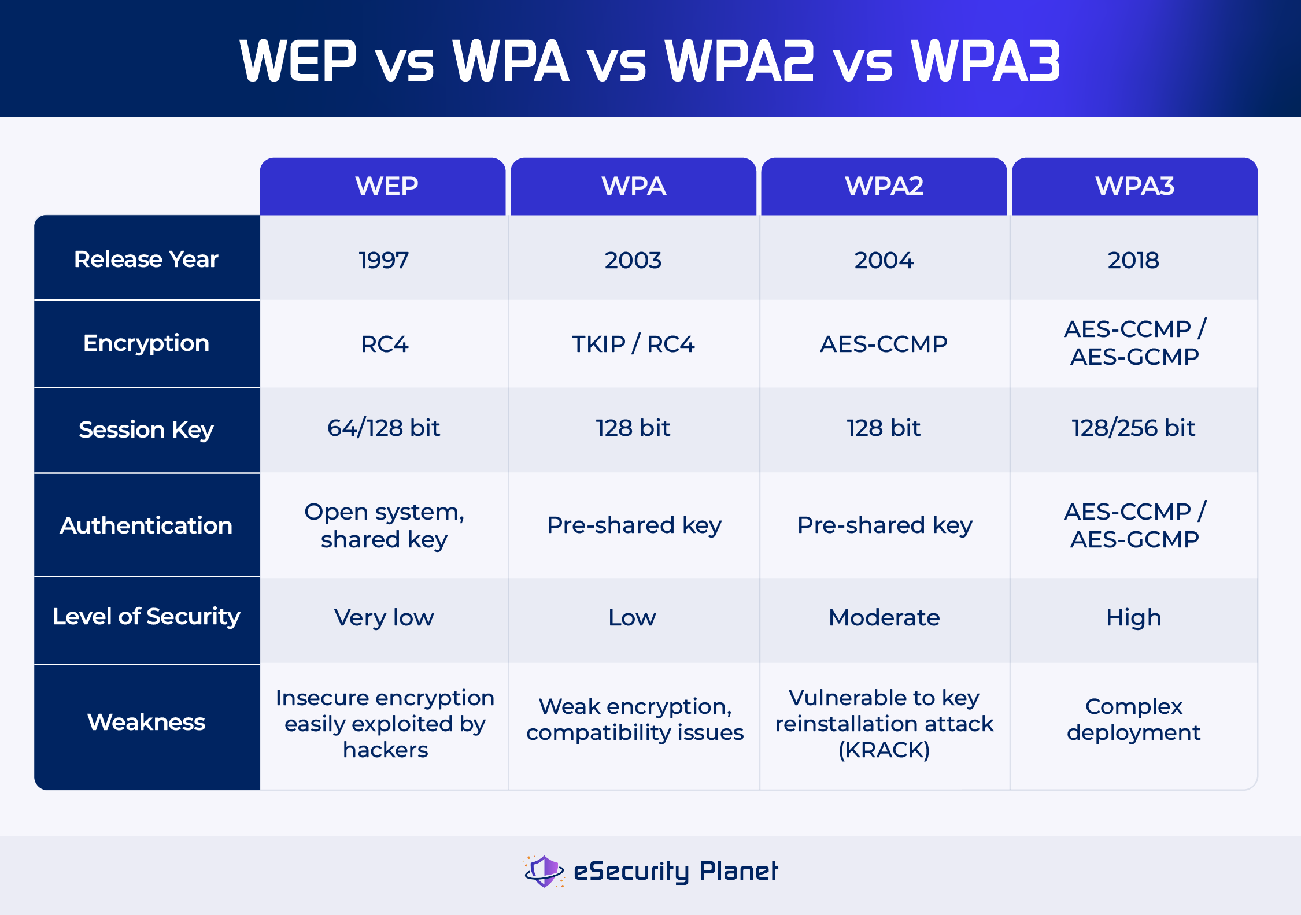
WEP vs WPA vs WPA2 vs WPA3
[8]

Slide 15
Authentification du Wi-Fi
Authentication at Layer 2 (L2) controls network access. And there is Two 802.11i authentication methods:
Mode Personal
Pre-Shared Key in WPA/WPA2 Personal mode, SAE in WPA3 Personal mode
Simplicity: Easy to configure with a shared key, no infrastructure required.
Compatibility: Works with almost all common devices.
SAE: Protects key exchange against interception.
Forward Secrecy: Past communications remain secure even if a key is compromised.
Mode Enterprise
IEEE 802.1X/EAP in WPA/WPA2/WPA3 Enterprise mode
Centralized Management: Individual authentication for each user.
Security: Utilizes a RADIUS server and an EAP method for robust security [9]

Slide 16
1.Pre-Shared Key in WPA/WPA2 Personal mode
Definition A Pre-Shared Key (PSK) is a shared secret, often a passphrase, used to authenticate devices on a wireless network. It is primarily utilized in WPA (Wi-Fi Protected Access) and WPA2 Personal modes.
Ideal Usage PSK is best suited for home and small office networks where deploying a centralized authentication server, like RADIUS, is impractical.
Functionality
Key Generation: The PSK is derived from a passphrase combined with the network’s SSID (Service Set Identifier) using the PBKDF2 (Password-Based Key Derivation Function 2) algorithm.
Authentication: Devices connect to the network by using the same PSK to authenticate with the access point.
Encryption: The WPA2 standard uses Advanced Encryption Standard (AES) with Counter Mode and Cipher Block Chaining Message Authentication Code Protocol (CCMP). AES ensures secure and symmetric encryption, while CCMP provides robust data integrity and confidentiality checks during communication. [10]

Slide 17
2. Simultaneous Authentication of Equals (SAE) in WPA3 Personal
Definition: Simultaneous Authentication of Equals (SAE) is a robust authentication protocol introduced with WPA3-Personal. It leverages the Dragonfly Key Exchange to provide stronger security by encrypting both key management and data frames through the use of Protected Management Frames (PMF).
Purpose: SAE addresses the vulnerabilities found in WPA2-PSK by generating unique keys for every authentication session, significantly improving resistance to offline password attacks.
Modes of Operation:
WPA3-SAE Mode: This is the standard mode, enforcing SAE authentication and PMF to deliver maximum security for WPA3-Personal networks.
WPA3-SAE Transition Mode: Designed for backward compatibility, this mode allows older devices that do not support SAE to connect using WPA2-PSK while maintaining enhanced security for SAE-compatible devices. It ensures a smooth user experience without compromising protection for modern devices. [11]

Slide 18
2. Simultaneous Authentication of Equals (SAE) in WPA3 Personal : How It Works
Key Generation:
In SAE, a unique cryptographic key is generated for every authentication process. Unlike WPA2, which reuses the same Pairwise Master Key (PMK), SAE ensures the PMK changes with each session, reducing the attack surface.
Authentication Process:
SAE requires mutual authentication between the Access Point (AP) and the station (e.g., laptop or mobile device) during the 4-way handshake process.
The cryptographic tools used in SAE make password-based attacks, such as brute force or dictionary attacks, significantly less effective.
Encryption and Integrity:
SAE implements Protected Management Frames (PMF), encrypting management frames to protect against spoofing and disconnection attacks (e.g., deauthentication attacks). [11]

Slide 19
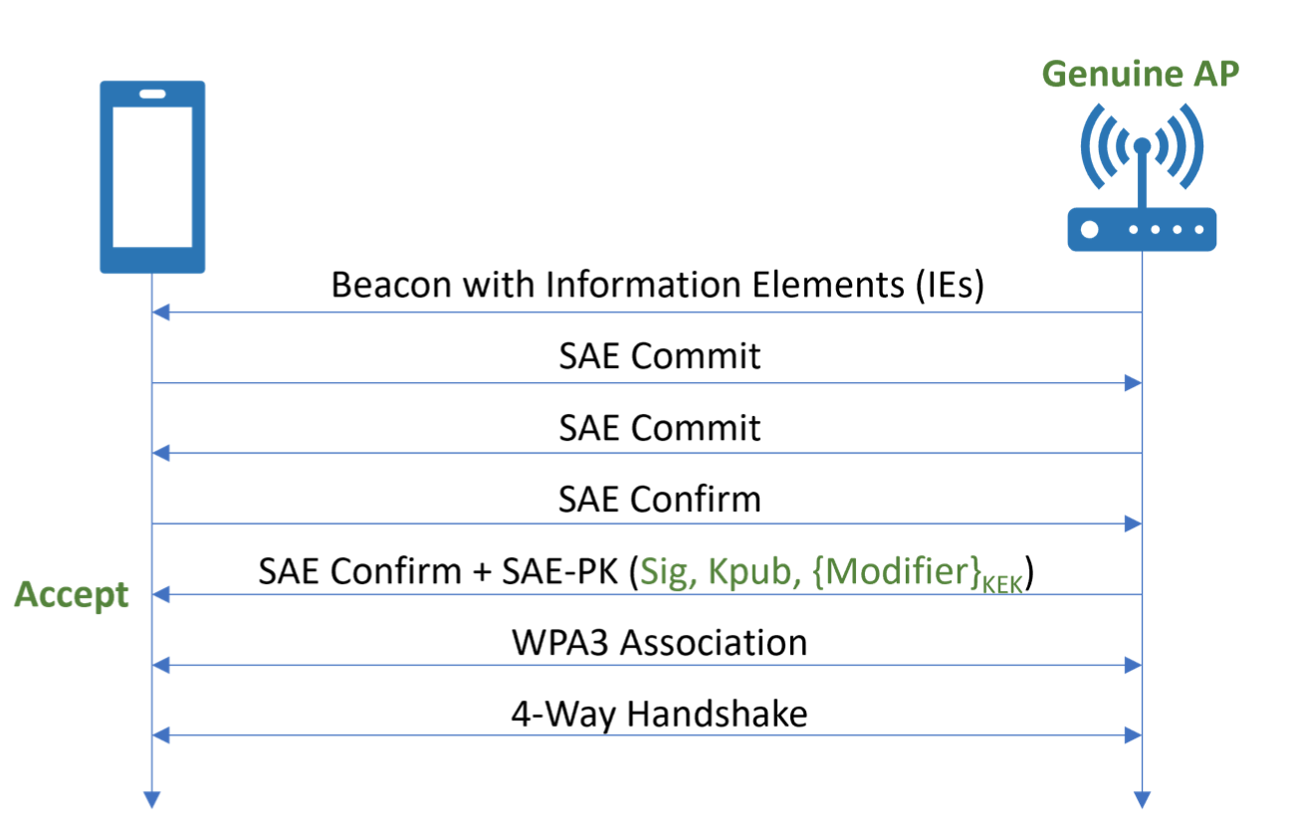
2. Simultaneous Authentication of Equals (SAE) in WPA3 Personal :
[11]

Slide 20
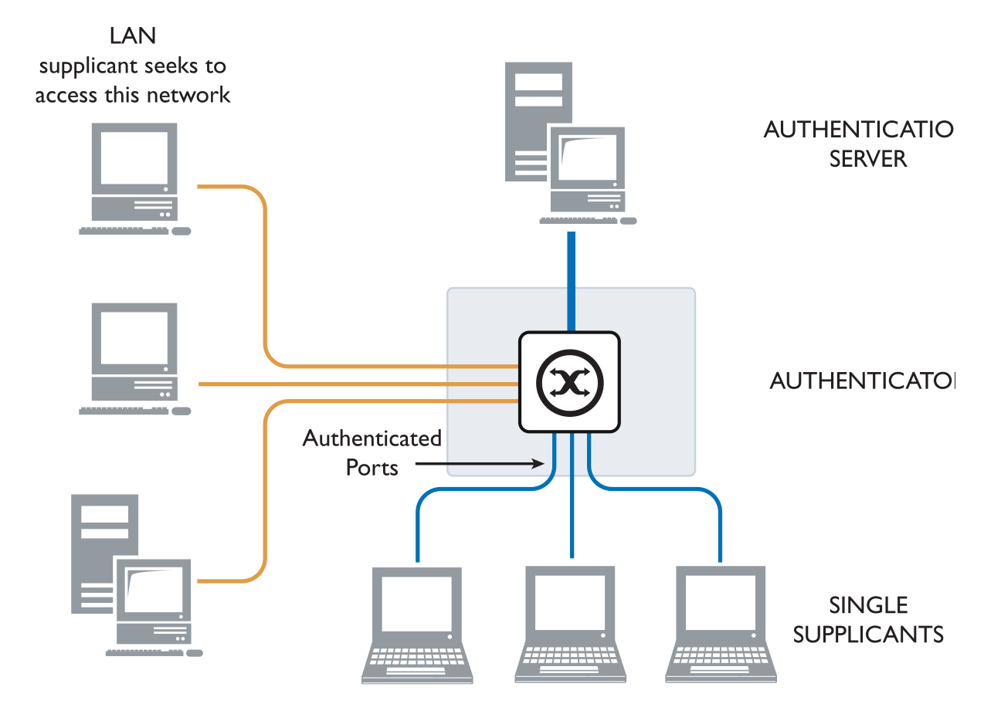
IEEE 802.1X/EAP in WPA/WPA Enterprise mode
Definition: The 802.1X Enterprise mode is a standard for port-based access control used to secure local area networks (LANs) and wireless local area networks (WLANs). It authenticates the identity of users and devices before granting them access to the network. So uses a RADIUS server and the EAP protocol for authentication. Users provide authentication information, including the user name and password, and are authenticated by an authentication server (generally a RADIUS server). [13]
Figure : The 802.1x System [12]

Slide 21
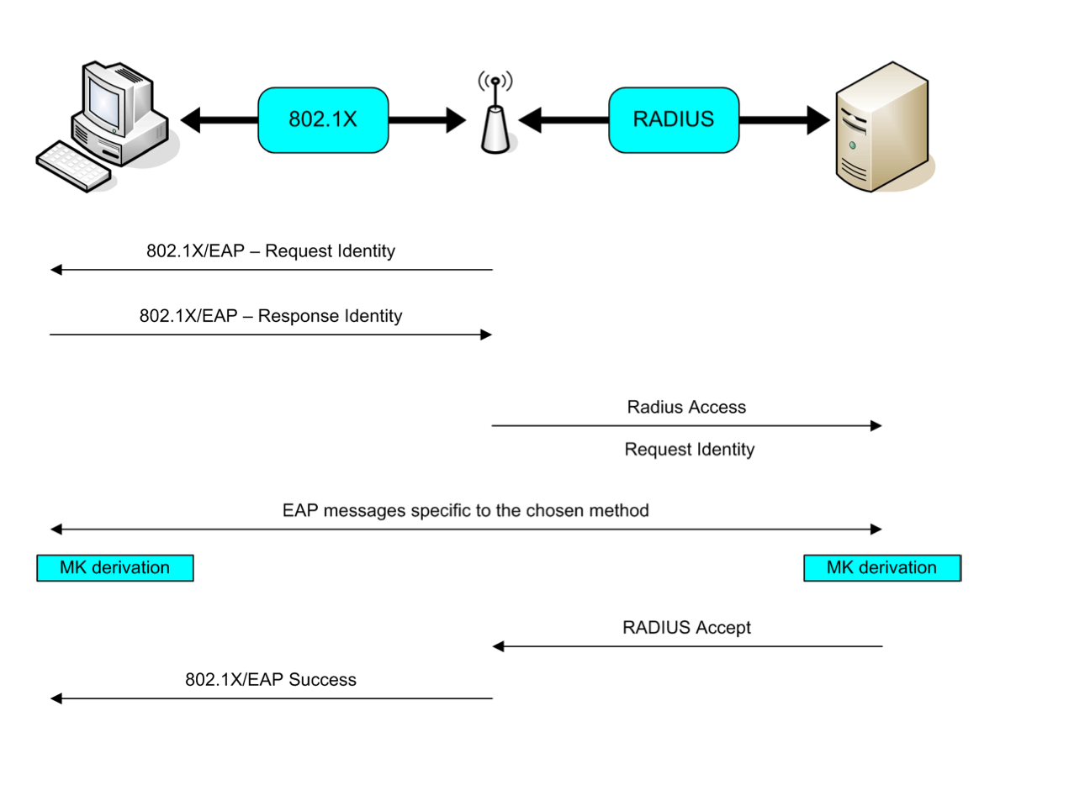
IEEE 802.1X/EAP in WPA/WPA Enterprise mode : RADIUS server
What is a RADIUS Server?
Authentication: The RADIUS server verifies the identity of users or devices attempting to connect to the network. It uses protocols like 802.1X to facilitate this process. Authorization: Once authenticated, the server determines what resources the user or device can access. Accounting: It keeps track of user activities, such as connection times and data usage, which can be useful for auditing and billing.
How It Works in WPA2 Enterprise
Client Request: When a user tries to connect to the Wi-Fi network, their device (the supplicant) sends an authentication request to the access point (AP).
Forwarding to RADIUS: The AP forwards this request to the RADIUS server.
Authentication Process: The RADIUS server checks the credentials against its database (often linked to an Active Directory or similar service).
Response: If the credentials are valid, the RADIUS server sends an "Access-Accept" message back to the AP, allowing the user to connect. If not, it sends an "Access-Reject" message. [14]
Figure . 802.1X authentication [14]

Slide 22
IEEE 802.1X/EAP in WPA/WPA Enterprise mode : EAP
The Extensible Authentication Protocol (EAP) is a versatile authentication framework created to improve security beyond basic username and password methods. Integrated into the PPP (Point-to-Point Protocol) authentication process, EAP offers a standardized structure that accommodates a range of authentication techniques. By supporting methods such as passwords, challenge-response tokens, and digital certificates, EAP streamlines the use of diverse techniques, minimizes the reliance on proprietary mechanisms, and ensures compatibility across various approaches. [14]
Several variations of EAP exist, including:

Slide 23
types of EAP
 | Server Authentication | Supplication Authentication | How it work | Security Risks
LEAP | Password Hash | Password Hash | LEAP uses dynamic WEP keys for mutual authentication, reducing the risk of Man-in-the-Middle (MitM) attacks | Identity exposed, Dictionary attack.
EAP-TLS | Public Key (Cer tificate) | Public Key (Certificate or SMART Card) | EAP-TLS provides mutual certificate-based authentication between the client and server, securing communication with a TLS tunnel, but requires certificate management on both sides. | Identity exposed
[14]

Slide 24
types of EAP
 | Server Authentication | Supplication Authentication | How it work | Security Risks
EAP-TTLS | Public Key (Cer tificate) | CHAP, PAP, MS-CHAP (v2), EAP | uses server-side certificates for mutual authentication within an encrypted tunnel, simplifying the implementation compared to EAP-TLS while dynamically generating per-user, per-session keys. | MitM attack
PEAP | Public Key (Cer tificate) | Any EAP such as EAP-MS-CHAPv2 or Public Key | PEAP encapsulates EAP within a secure TLS tunnel, requiring only server-side certificates, and offers robust protection against sniffing attacks, similar to EAP-TTLS. | MitM attack; identity hidden in phase 2 but potential exposure in Phase 1
[14]

Slide 25
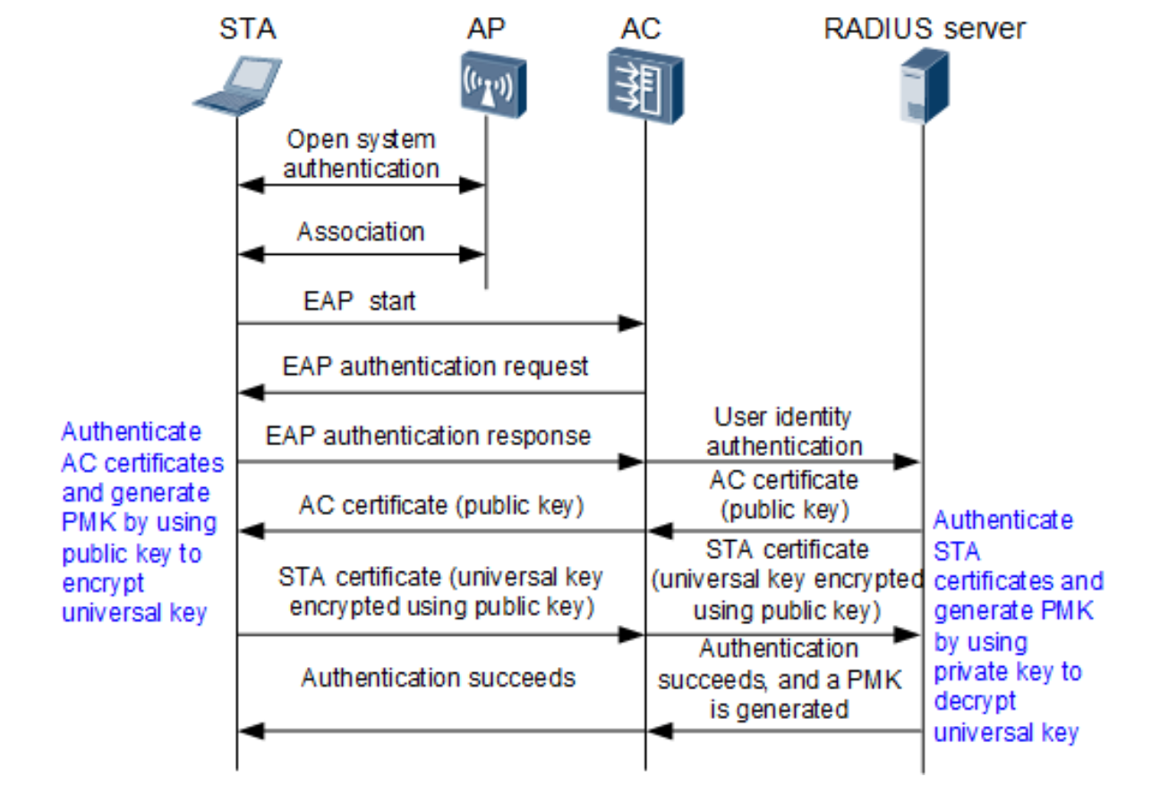
IEEE 802.1X/EAP in WPA/WPA2 Enterprise mode : EAP-TLS
Open System Authentication: The STA starts the authentication process with the AP.
Association: The STA connects to the AP to establish communication.
EAP Start: The STA sends a message to initiate EAP authentication.
EAP Authentication Request: The AP passes authentication requests to the AC and RADIUS server.
Identity Verification: The STA shares its identity, which the RADIUS server verifies.
Certificate Exchange: Certificates are exchanged and validated between the STA and the RADIUS server.
Key Creation: The RADIUS server generates a PMK after verifying the STA’s certificate.
Authentication Confirmation: The STA is notified of successful authentication.
Secure Communication: The STA and AP establish an encrypted link using the PMK. [15]
[15]

Slide 26
IEEE 802.1X/EAP in WPA3 Enterprise mode :
WPA3-Enterprise is tailored for organizations like enterprises, governments, and financial institutions that demand advanced security features. Built upon WPA2-Enterprise, it introduces an optional 192-bit mode with the following enhancements:
Enhanced Data Security: Utilizes the Suite-B 192-bit security suite to strengthen encryption through longer key lengths.
Stronger Key Protection: Employs the HMAC-SHA-384 algorithm during the four-way handshake to securely derive and protect keys.
Improved Traffic Encryption: Uses the 256-bit Galois/Counter Mode Protocol (GCMP-256) to safeguard wireless traffic once devices are connected.
Management Frame Security: Implements the 256-bit Galois Message Authentication Code (GMAC-256) to protect multicast management frames.
Unlike WPA2-Enterprise, which supports multiple EAP authentication methods, WPA3-Enterprise exclusively relies on EAP-TLS. It also supports the following EAP cipher suites for enhanced cryptographic security:
TLS_ECDHE_ECDSA_WITH_AES_256_GCM_SHA384
TLS_ECDHE_RSA_WITH_AES_256_GCM_SHA384
TLS_DHE_RSA_WITH_AES_256_GCM_SHA384.[15]

Slide 27
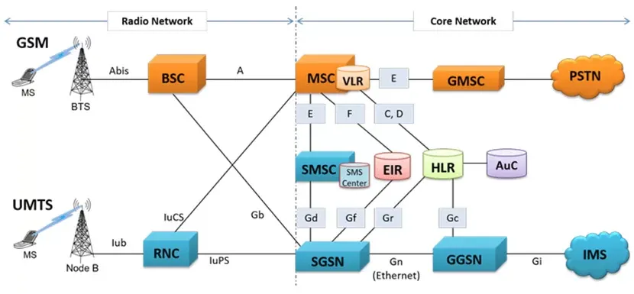
Mobile Networks Authentication in GSM/2G Mobile Networks
Architecture of GSM and UMTS (3G) Networks and Their Different Components
GSM Network Components:
MS (Mobile Station).
BTS (Base Transceiver Station).
BSC (Base Station Controller): Manages the BTS and controls radio communication and mobility management.
MSC (Mobile Switching Center): Handles call switching and manages voice connections between mobile stations.
VLR (Visitor Location Register): Contains subscriber information for the area where they are located.
HLR (Home Location Register): A central database containing subscriber information and mobility management.
EIR (Equipment Identity Register): Registers the identities of mobile devices.
SMSC (Short Message Service Center): Manages the sending and receiving of text messages (SMS).
AuC (Authentication Center): Ensures user authentication.
PSTN (Public Switched Telephone Network): Traditional fixed telephone network.
UMTS Network Components:
RNC (Radio Network Controller): Manages radio resources and the connection between Node B stations and the network.
SGSN (Serving GPRS Support Node): Manages authentication, mobility, and data session management.
GGSN (Gateway GPRS Support Node): Acts as a gateway between the GSM/UMTS network and external networks (internet, other IP networks).
IMS (IP Multimedia Subsystem): Allows the integration of multimedia services, such as Voice over IP (VoIP).
IuCS, IuPS: Interfaces for managing communication and data services.
Main Difference:
GSM is primarily a mobile telephony network based on circuit-switching (for voice calls) and SMS. It uses a simpler, older architecture.
UMTS (3G) is more advanced, using packet-switching technologies (for data management) and supports multimedia services, video calls, and higher data speeds with the HSPA (High-Speed Packet Access) architecture. The network management is also more distributed with components such as the RNC and GGSN.
[16]

Slide 28
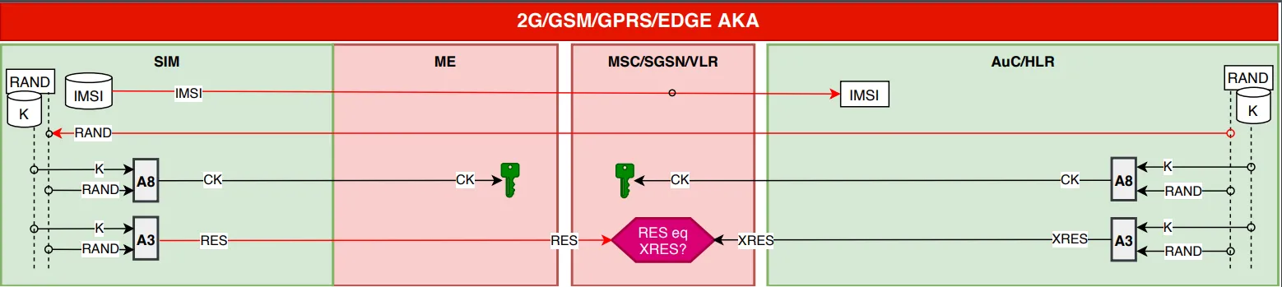
MOBILE NETWORKS Objectives of GSM/2G Authentication
Introduction and Objectives of GSM/2G Authentication Objective: GSM/2G authentication aims to ensure the legitimacy of the user equipment (UE) when attempting to connect to the mobile network, by verifying that the UE is indeed the subscriber it claims to be. It relies on a mechanism based on a challenge-response principle.
Authentication Process: Identifiers Used: During authentication, the UE can send either a permanent identifier (IMSI) or a temporary identifier. - IMSI: A permanent and unique identifier for the subscriber.
- TMSI: A temporary identifier that preserves the confidentiality of the IMSI. It is used after the first exchange and helps reduce the risk of user tracking.
Main Actors: - AuC (Authentication Center): An authentication center often co-located with the HLR (Home Location Register), containing subscriber information such as the secret key Ki.
- UE (User Equipment): The mobile phone or other equipment of the user. - BTS (Base Transceiver Station): Manages the radio communication with the UE. - MSC (Mobile Switching Center): Coordinates the management of calls and sessions with the network. [17]
[17]

Slide 29
MOBILE NETWORKS GSM/2G Authentication
Authentication Process
1. Initial Identification:
Authentication begins when the UE (User Equipment) sends its identifier (IMSI or TMSI) to the network (via the BTS and MSC). If the IMSI is used, it is transmitted in plain text during the early stages of communication, but it is quickly replaced by a TMSI for privacy reasons.
2. Shared Secret and Encryption Key:
The UE and the AuC share a secret key Ki (128 bits), which is used to generate the authentication response and for encrypting communications.
Ki : This key never leaves the UE (stored in the SIM card) and the AuC.
3. Generation of the Challenge (RAND):
The AuC generates a random number (RAND) and sends it to the MSC and the UE to begin the authentication process.
SQN : A sequence number is also used to track transactions and prevent the reuse of the same keys. [17]
[17]

Slide 30
MOBILE NETWORKS GSM/2G Authentication
4. Generation of the Response:
Algorithm A3 : The UE uses the RAND and the secret key Ki to calculate a response (SRES) via the A3 algorithm.
The SRES generated by the UE is an answer to the challenge (RAND).
The A3 algorithm is one-way and difficult to reverse, meaning that an attacker capturing the SRES will not be able to calculate Ki..
5. Network Response (XRES) :
On its side, the MSC and AuC use the same parameters (RAND, Ki, SQN) to calculate an expected response (XRES).
XRES : If the response calculated by the network matches that of the UE, the authentication is successful. [17]

Slide 31
MOBILE NETWORKS GSM/2G Authentication
Validation and Securing of Communications
6. Comparison of Responses (SRES and XRES):
The MSC compares SRES (calculated by the UE) and XRES (calculated by the MSC and the AuC).
If the values match, the authentication is successful, proving that the UE indeed possesses the shared secret key (Ki). (Ki).
If the values do not match, network access is denied.
7. Securing the Communication:
Once authentication is successful, session keys are derived to secure data exchanges.
A5 : The A5 algorithm is used for encrypting communications between the UE and the base station (BTS).
Session Key (Kc) : The encryption key (Kc) is derived from the secret key Ki and is used to protect the exchanged data.
Encryption is performed using the XOR (exclusive OR) operation with the session key.
8. Use of TMSI for Confidentiality::
TMSI (Temporary Mobile Subscriber Identity) is used in later stages to maintain the confidentiality of the IMSI.
is shorter than the IMSI (only 4 bytes compared to 8 bytes for the IMSI), reducing radio resource usage and improving security.
Securing Communication Between Network/UE:
Encryption is applied to every frame sent between the UE and the BTS, ensuring that even if an attacker intercepts the frames, they will not be able to decrypt them without the correct session key.[17]

Slide 32
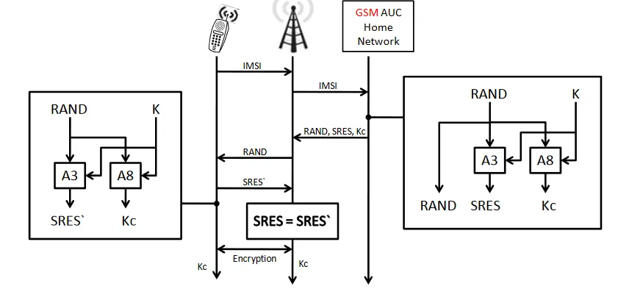
Confidentiality of the IMSI: The IMSI is rarely used after the first exchange, and it is the TMSI that is used to protect the subscriber's identity. Security of Communications: Data encryption with the A5 algorithm and the use of a session key ensure the confidentiality of exchanges. Protection Against Eavesdropping: Even if an attacker listens to the traffic, they cannot determine the shared secret key (Ki) from RAND and SRES without a large number of attempts. [18]
Figure. GSM Authentication[19]

Slide 33
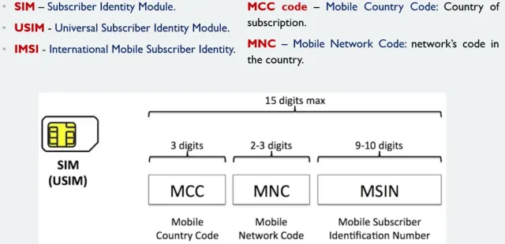
The difference between SIM and USIM ( MIlenage: 3GPP)
Caractéristique | SIM | USIM
Full Name | Subscriber Identity Module | Universal Subscriber Identity Module
Usage | 2G and 3G Networks | 3G, 4G, and 5G Networks
Security | A3, A8, COMP128 algorithms | MILENAGE algorithms
Storage capacity | Limited (32-64 Ko) | Big(256 Ko)
Applications | Basic mobile functions | Advanced applications (mobile payment, videoconferencing)
Compatibility | Compatible with 2G and 3G devices | Compatible with 2G, 3G, 4G and 5G devices
[20]

Slide 34
The difference between SIM and USIM ( MIlenage: 3GPP)
MILENAGE is a set of algorithms used in 3G, 4G, and 5G networks for authentication and key generation, based on AES (Advanced Encryption Standard).
MILENAGE: Authentication and Key Generation Algorithms
Operation:
f1 and f1: Generate an authentication code (MAC) from RAND and the secret key (K).
f2: Generates the authentication response (RES).
f3: Generates the encryption key (CK).
f4: Generates the integrity key (IK).
f5 and f5: Generate the anonymization key (AK).
Authentication Process:
The network generates a random number (RAND) and sends it to the UE.
The UE uses MILENAGE to calculate MAC, RES, CK, IK, and AK from RAND and K.
The UE sends the response (RES) to the network, which compares it with the expected value (XRES).
If they match, authentication is successful, and CK and IK keys are used to secure communications.
Security: MILENAGE ensures mutual authentication and protects the confidentiality and integrity of the exchanged data.

Slide 35
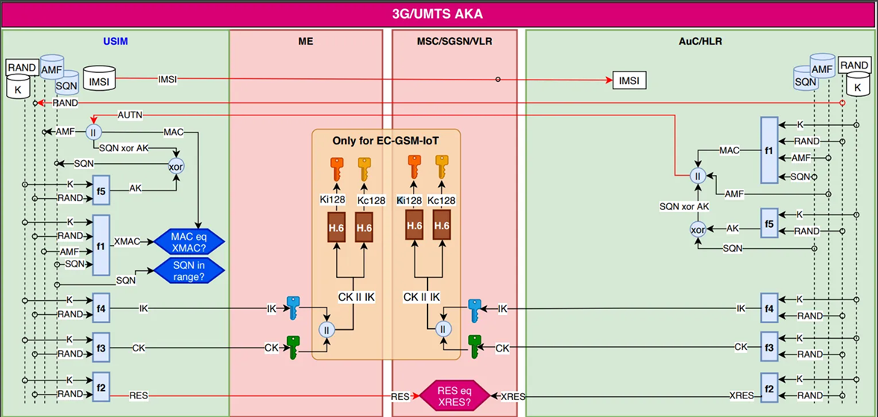
MOBILE NETWORKS 3G Authentication in UMTS Networks
Steps and Mechanisms of 3G (UMTS) Authentication
Initialization (Generation of Random Values)
Generation of "RAND": The network generates a random value (RAND) used in the authentication process.
This value is sent to the User Equipment (UE) via the network.
Authentication Transmission (Shared Authentication)
AMF (Authentication Management Function) generates a challenge based on the RAND value.
AMF and AuC/HLR (Authentication Center / Home Location Register) use the session key K to generate an authentication vector, which will be sent to the UE. [17]
[17]

Slide 36
MOBILE NETWORKS 3G Authentication in UMTS Networks
Transmission of IMSI: The UE receives RAND and the network challenge. The UE uses its IMSI identifier to participate in the authentication.
3. Calculation of the Cryptographic Response (F1, F2, etc.)
MAC Calculation: The UE uses the F1 function (Message Authentication Code) to create a MAC code from RAND, the K key, and the sequence number (SQN).
SQN Range Verification: The network checks whether the sequence number (SQN) is within an acceptable range.
Integrity Calculation: The F2 function calculates the integrity key (CK) from RAND and K to ensure the integrity of the data.
4. Calculation of the Encryption Key
F3 and F4: The F3 and F4 functions generate the keys CK and IK (integrity and encryption keys) from RAND and K, used to protect the communications. [21]

Slide 37
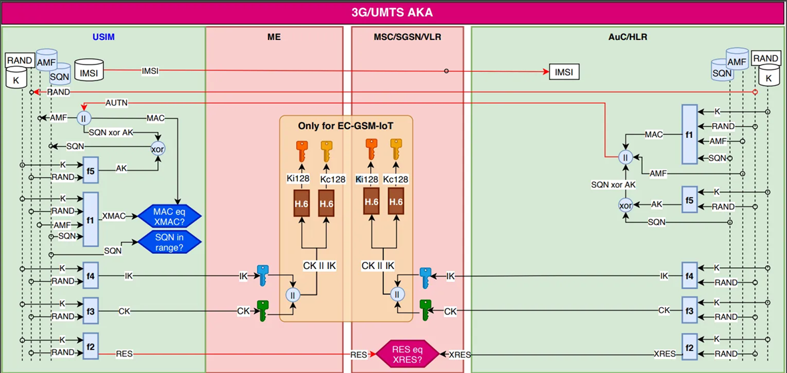
MOBILE NETWORKS 3G Authentication in UMTS Networks
5. Authentication of the UE (Response Verification)
Verification of the UE's Response: The UE generates a response (RES) and compares it with the expected result (XRES) calculated by the network.
If the responses match, the authentication is successful. Otherwise, the process fails.
6. Verification for EC-GSM-IoT (if applicable)
Generation of Specific Keys for EC-GSM-IoT: If the UE supports EC-GSM-IoT, specific keys Ki128 and Kc128 are used, and H.6 functions are applied to enhance authentication security.
7. Finalization
If all steps are validated (verification of MAC, XMAC, and RES values), the authentication is successful, and the secure session is established. [22]
[22]

Slide 38
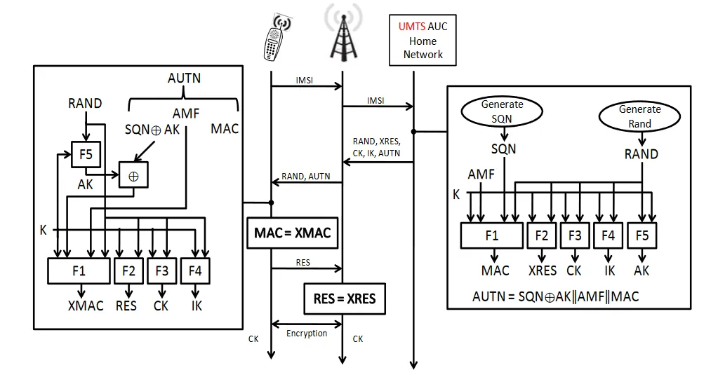
MOBILE NETWORKS 3G Authentication in UMTS Networks
Summary:
Sending the RAND value and network challenge to the UE.
Calculating the MAC and response by the UE based on the received challenge.
Verifying the MAC, integrity, and sequence numbers.
Calculating and comparing encryption key values.
Finalizing with verification of the response RES.
Figure . UMTS-AKA Authentication Protocol [19]

Slide 39
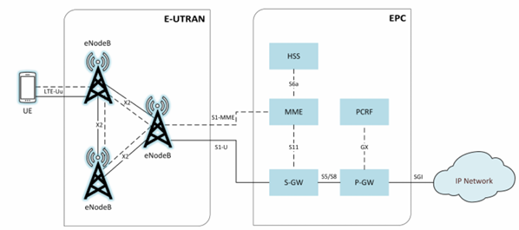
MOBILE NETWORKS Authentication in 4G LTE Networks
Here is the architecture of 4G LTE:
Figure - LTE Network Architecture[23]

Slide 40
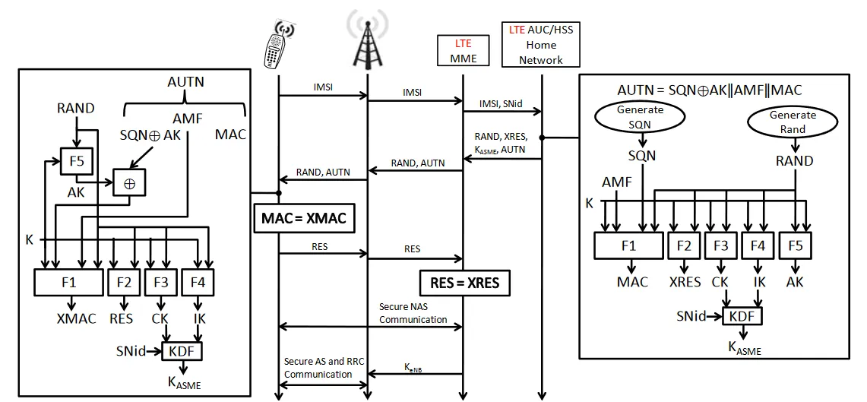
MOBILE NETWORKS Authentication in 4G LTE Networks
1. Initiate authentication process
- Generation of random RAND value and AUTN authentication:
- The network generates a random RAND value for each authentication session. This random value is used in cryptographic calculations to prevent replay attacks.
- The AUTN authentication token is also generated by the AUC (Authentication Center), and contains several pieces of information:
- SQN (Sequence Number): A unique sequence number which is used to ensure that each authentication session is unique, and to prevent replay attacks.
- AK (Authentication Key): Key used to calculate authentication.
- AMF (Authentication Management Field): Field containing authentication management information.
- MAC (Message Authentication Code): Used to ensure authentication integrity and verify that the message has not been modified. These values are sent to the UE user terminal.[19]
[19]

Slide 41
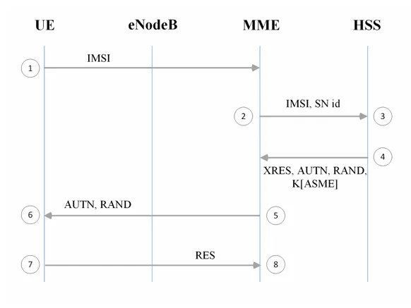
MOBILE NETWORKS Authentication in 4G LTE Networks
2. Verification of the Message by the UE:
- Reception of RAND and AUTN by the UE:
- The UE terminal receives the `RAND` and `AUTN` values sent by the network.
- Calculation of the MAC and the RES Response by the UE:
- MAC: The UE uses the RAND value, the AK key, and other parameters to calculate a MAC. It must verify that the calculated MAC matches the one received from the network.
- Validation of MAC: If the calculated MAC by the UE matches the one sent by the network, it means the network and the UE are legitimate, and the communication has not been altered. If the MAC does not match, the authentication fails.
- Generation of the RES Response: The UE uses the RAND value and the key K (shared between the UE and the network) to generate a RES response to send to the network.[24]
[19]

Slide 42

3. Verification of the RES Response:
- Sending RES to the network:
- The UE sends the RES response it calculated using the RAND value and the key K to the network. This response is then compared with the expected response, XRES.
- Comparison with XRES at the network level:
- The network calculates the XRES value using the same parameters (RAND and K). It compares the XRES value with the RES sent by the UE.
- If the values match, it means authentication is successful and the UE is legitimate.
4. Key Generation:
Once authentication is successful, the network and the UE generate security keys to secure future communications. The following steps are crucial for key generation:
- Calculation of encryption and integrity keys:
- CK (Cipher Key): Encryption key generated to secure communications between the UE and the network, derived from RAND and K.
- IK (Integrity Key): Integrity key generated to ensure that messages exchanged between the UE and the network are not altered. It is also derived from RAND and K.
- Session key KASME (Key for Access and Session Management Entity):
- KASME: Main key used to protect session data and secure exchanges between the UE and the network (NAS and AS). It is derived from CK and IK and is used to secure communication.
- KDF (Key Derivation Function): A function used to derive additional keys from KASME, such as K_NB (key for UE's network layer communication). [24]
[19]

Slide 43
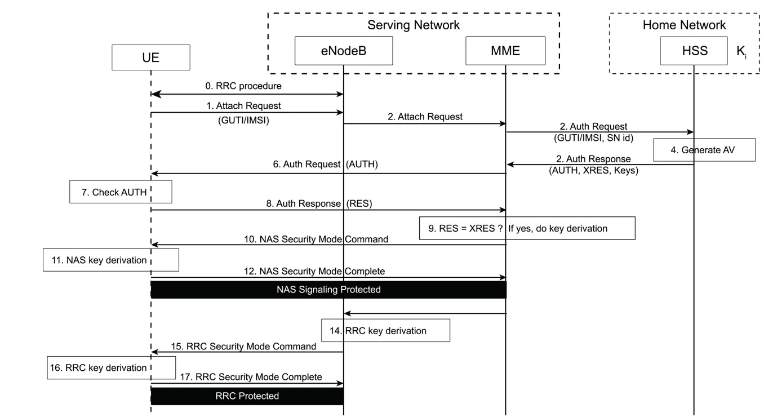
MOBILE NETWORKS Authentication in 4G LTE Networks
5. Secure Communication with Generated Keys:
Once the keys (CK, IK, KASME, K_NB) are generated, they are used to secure data exchanges between the UE (User Equipment) and the network.
NAS (Non-Access Stratum) Communication: Refers to communication between the UE and the network unrelated to radio access management (e.g., session management, authentication).
AS (Access Stratum) and RRC (Radio Resource Control) Communication: Involves radio resource management and connection setup, with CK and IK securing these exchanges.
6. Authentication and Session Finalization:
Authentication Finalization: Authentication is successful if all MAC, RES, and XRES checks are positive. The network and UE can then exchange data securely.
Secure Communication: With the generated keys (CK, IK, KASME), secure data exchanges can begin, including service data (internet, calls, etc.).[25]
Figure : The 4G authentication procedure[26]

Slide 44

Steps of the 4G LTE Authentication Process
0.RRC Procedure (Radio Resource Control): Establishes the connection between the UE (User Equipment) and the network to initiate the authentication procedure.
Attach Request: The UE sends an attach request to the eNodeB with the identifier (GUTI/IMSI).
Attach Request to the MME: The eNodeB sends the attach request to the MME to manage attachment and mobility.
Authentication Request: The MME sends the authentication request to the HSS.
Generation of the Authentication Vector (AV): The HSS generates an AV vector with parameters like RAND, SQN, K, XRES, and AUTN.
Authentication Response: The HSS responds with the AV vector to the MME.
Authentication Request to the UE: The MME sends RAND and AUTN to the UE.
Authentication Verification: The UE calculates a response (RES) and sends it to the MME.
Comparison of RES with XRES: The MME compares RES and XRES; authentication is successful if they match.
NAS Security Mode Command: If authentication is successful, the MME sends a security command to the UE for NAS signaling.
NAS Security Mode Complete: The UE confirms the application of the NAS security mode.
Protected NAS Signaling: Communication between the UE and the network is protected.
RRC Security Mode Command: The MME configures security at the RRC radio control level.
RRC Key Derivation: The MME generates the keys necessary to secure the RRC communication.
RRC Security Mode Command: The UE applies the RRC keys to protect the messages.
RRC Key Derivation: The UE generates the RRC security keys for communication.
RRC Security Mode Complete: The UE confirms the securing of the RRC communications.
Protected RRC Communication: The RRC communication between the UE and the network is secured.[26]
Figure : The 4G authentication procedure[26]

Slide 45
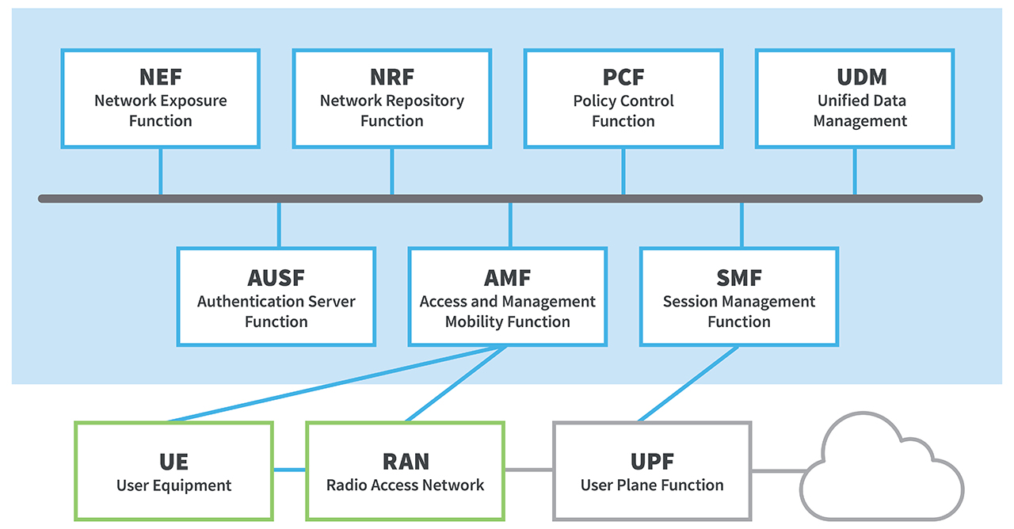
5G Network Architectur
In 5G, several new Network Functions (NFs) evolve from 4G concepts:
AUSF (Authentication Server Function) manages authentication for both 3GPP and non-3GPP access.
UDM (Unified Data Management) stores user data and handles authentication credentials, user identification, and access authorization.
SDSF and UDSF manage structured and unstructured data respectively, with UDR handling subscription and policy data.
AMF (Access and Mobility Management Function) manages access authentication, registration, and mobility across both 3GPP and non-3GPP networks.
SMF (Session Management Function) handles session management, IP address allocation, policy enforcement, and QoS.
PCF (Policy Control Function) manages policy rules for NFs.
NEF (Network Exposure Function) exposes services and manages data flow between NFs, while NRF (NF Repository Function) helps discover and store NFs. [27]
5G architecture and its main network functions.
All of the NFs can connect to UDSF, NEF and NRF, therefor they are not shown in the Figure. RAN stands for Radio Access Network [27]

Slide 46
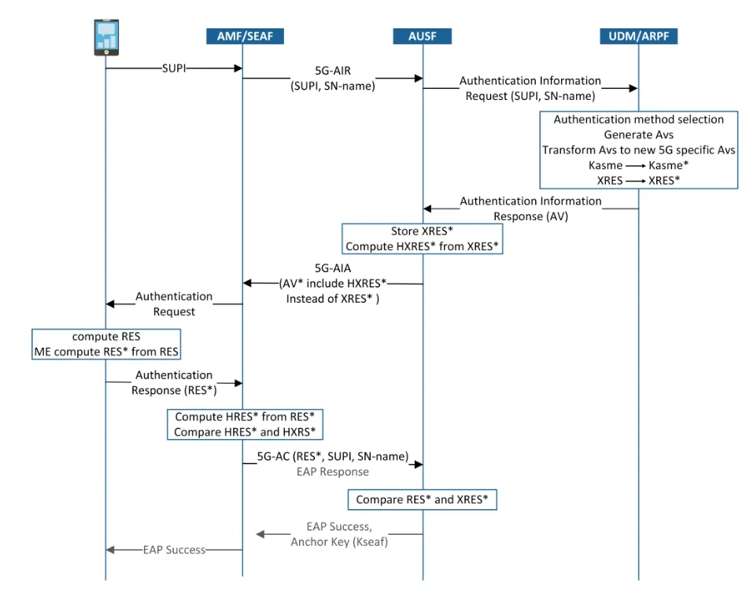
5G Network authentification
5G authentication steps according to figure :
SUPI (Subscriber Permanent Identifier) :
UE (User Equipment) sends the subscriber's permanent identifier, SUPI, to SEAF (Security Anchor Function) or AMF (Access and Mobility Management Function).
The SUPI is used to uniquely identify the subscriber in the network. This process is the starting point for authentication5G-AIR (Authentication Initiation Request) :
The SEAF/AMF sends an authentication initiation request message to the AUSF (Authentication Server Function). This message contains the SUPI (or SUCI) and the serving network name (SN-name).
Authentication Information Request:
AUSF sends the authentication information request to the UDM (Unified Data Management), which manages user subscription data.
Generation of AVs (Authentication Vectors) :
UDM generates Authentication Vectors (AVs), containing key information like session key (KSEAF), authentication key (XRES), and expected responses after transformation.
Fig. 5G-AKA and EAP-AKA'. The main focus is on the 5G-AKA. The computation of RES* in the ME (Mobile Equipment) is in the same way as the computation of XRES* in the ARPF and The computation of HRES* in the SEAF is in the same way as the computation of HXRES* in the AUSF[27]

Slide 47
5G Network authentification
5. Registration and Transformation of AVs::
The AUSF stores the XRES and calculates HXRES from XRES, while the UDM transforms the received AVs into new AVs specific to the 5G system..
6. Calculation and Comparison of Responses:
The UE (user equipment) calculates an authentication response (RES) and sends it to the SEAF/AMF.
The SEAF/AMF verifies this response (RES) and compares it with the expected response (XRES).
7. Authentication Validation:
If the responses (RES and XRES) match, authentication is successful, and AMF/SEAF sends a success confirmation to the network.
8. Anchor Key (KSEAF): :
. Once authentication is successful, the anchor key (KSEAF) is used to ensure security and integrity of communications between the UE and the network, enabling secure session management.
9.EAP (Extensible Authentication Protocol) Success :
Authentication success is confirmed by an EAP Success message, allowing the UE to access the network securely.
Fig. 5G-AKA and EAP-AKA'. The main focus is on the 5G-AKA. The computation of RES* in the ME (Mobile Equipment) is in the same way as the computation of XRES* in the ARPF and The computation of HRES* in the SEAF is in the same way as the computation of HXRES* in the AUSF[27]

Slide 48
5G Network authentification
Summary of Key Functions in the Process:
SEAF/AMF: Responsible for security and mobility management, initiating authentication and validating the response.
AUSF: Performs authentication using authentication vectors.
UDM: Provides subscription information and generates 5G-specific authentication vectors.
KSEAF: The anchor key used to protect communication after authentication.
This authentication process ensures confidentiality, integrity, and security of communications in the 5G network by employing advanced cryptographic and mutual authentication techniques
Fig. 5G-AKA and EAP-AKA'. The main focus is on the 5G-AKA. The computation of RES* in the ME (Mobile Equipment) is in the same way as the computation of XRES* in the ARPF and The computation of HRES* in the SEAF is in the same way as the computation of HXRES* in the AUSF[27]

Slide 49
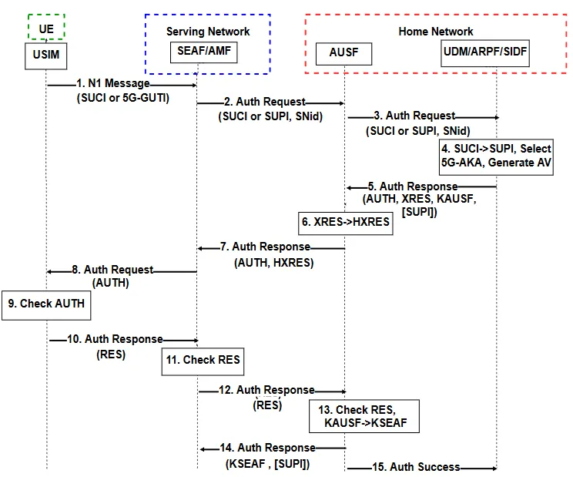
Message N1 (SUCI or 5G-GUTI): The UE sends an authentication message containing either a SUCI (Subscriber Concealed Identifier) or a 5G-GUTI (Global Unique Temporary Identifier 5G) to the access network.
Authentication request (SUCI or SUPI, SNid): The SEAF/AMF in the serving network sends the authentication request to the AUSF server in the home network, including the subscriber identifier (SUCI or SUPI) and network identifier (SNid).
Authentication request (SUCI or SUPI, SNid): The AUSF forwards the request to the UDM in the home network.
Decryption of SUCI -> SUPI, Selection of 5G-AKA method, AV Generation: The UDM decrypts SUCI to obtain SUPI, selects the 5G-AKA authentication method, and generates an authentication vector (AV).
Authentication response (AUTH, XRES, KAUSF, [SUPI]): The UDM sends the authentication response to AUSF, including an AUTH token, XRES, KAUSF key, and SUPI if necessary.
XRES -> HXRES: The home network compares XRES with the expected HXRES value.
Authentication response (AUTH, HXRES): The response containing AUTH and HXRES is returned to SEAF/AMF in the serving network.
Authentication request (AUTH): SEAF/AMF verifies the AUTH token and sends it to the UE for validation.
AUTH verification: The UE checks if the AUTH token is correct.
Authentication response (RES): The UE sends a response (RES) to the network.
RES verification: The network verifies the RES response.
Authentication response (RES'): The network sends another authentication response.
RES verification, KAUSF -> KSEAF: SEAF/AMF verifies the response, and KAUSF is used to derive KSEAF.
Authentication response (KSEAF, [SUPI]): SEAF/AMF returns the final response with KSEAF and SUPI.
Authentication success: Authentication is successful.
Each step describes the interaction between the UE, serving network, AUSF server, UDM, and the security key management process.[28]
Figure . 5G-AKA procedure for the UE authentication [28]

Slide 50
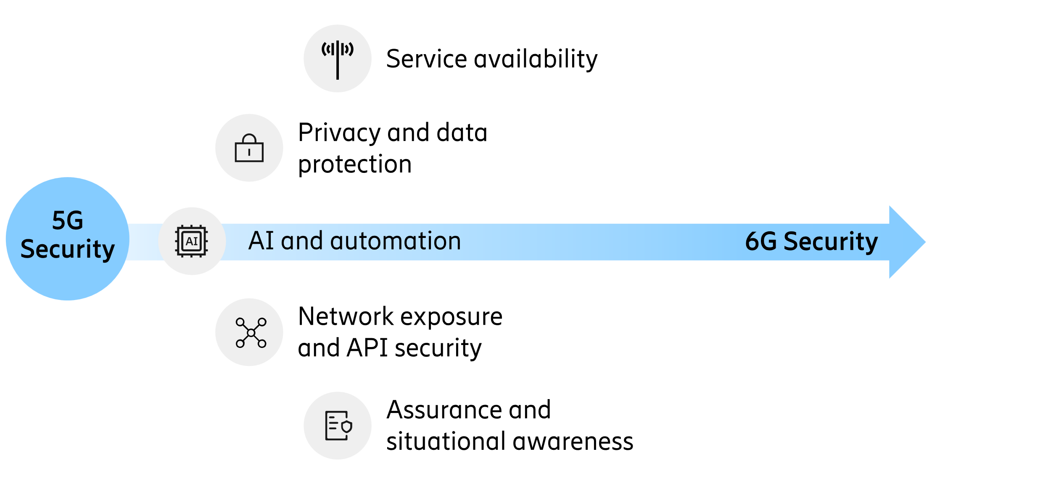
6G Network
6G Authentication: Key Principles
Key Principles:
Multi-Level Authentication: Verifies the identity of the user, device, and network for complete security.
Advanced Cryptography: Uses robust cryptographic techniques (AES-256, post-quantum algorithms) to ensure confidentiality and integrity.
Dynamic Authentication: Adapts based on the context (healthcare, finance, IoT) with enhanced mechanisms (multi-factor authentication).
Role-Based Access Control (RBAC): Restricts access based on users' or devices' roles and profiles.
Interoperability with Various Networks: Supports 3GPP, non-3GPP, IoT, and private networks with consistent security.
Trust-Based Authentication: Verifies identities based on users' and devices' history and reputation in the network.
Privacy Protection: Ensures global confidentiality of personal data.[29]
6G Security [30]

Slide 51
Advanced methods and the new challenges of authentication
Biometric authentication
Facial recognition challenges
Facial recognition systems can run into difficulties when a person's appearance changes: a new hairstyle, beard, make-up or face mask. These variations can increase errors, such as “false acceptances” or “false rejections”. Efficiency therefore depends on the quality of the tools and the environment. In critical contexts such as nuclear power plants, strict parameters are preferred to avoid any intrusion, even if this increases false releases.
The reliability of biometrics
Biometrics uses statistical algorithms, which do not guarantee 100% reliability [31]. Multimodal biometrics (e.g. face and fingerprints) reduce errors but require high-performance acquisition tools and algorithms.
For security reasons, it is recommended integrating solutions such as microprocessor cards, which enable local verification without connection to a central database.

Slide 52
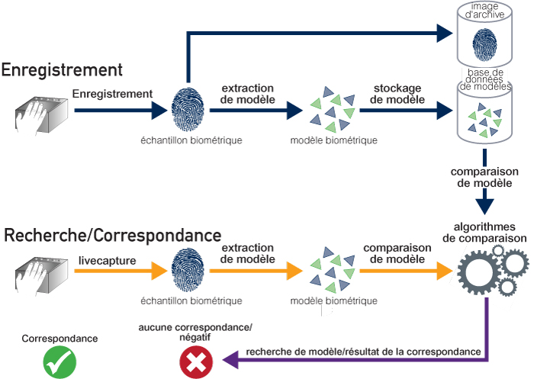
Advanced methods and the new challenges of authentication
Biometric authentication
Identification vs. authentication
Identification: answers “Who are you?” (1:N verification). This requires centralized databases.
Authentication: answers “Are you this person?” (1:1 verification). This is more respectful of personal data, thanks to decentralized media such as smart cards.

Slide 53
Advanced methods and the new challenges of authentication
Biometric authentication
Protection of biometric data
Centralized biometric data are exposed to risks: hacking, misappropriation or interconnection with other files. Authorities therefore favor decentralized solutions to guarantee citizens' privacy.
Legal frameworks
In Europe, the GDPR imposes strict rules: explicit consent, the right to be forgotten, and sanctions in the event of violation. Outside the EU, protection varies widely from country to country. For example, in the United States, only certain local jurisdictions have specific laws.
Integration into eSIMs:
eSIMs offer a programmable and dynamic framework compared to traditional SIM cards. This allows for integrating advanced authentication mechanisms, including biometrics. For instance, a mobile device could require both biometric authentication (like facial recognition) and the cryptographic credentials on the eSIM for network access[32].

Slide 54
Advanced methods and the new challenges of authentication
Password-less authentication
Passwordless authentication is a form of authentication other than a password, enabling secure user access. However, “passwordless experience” is not necessarily synonymous with “passwordless authentication”. For example, push notification authentication offers the user a password-free experience, but in reality, still relies on the use of an underlying password.
True passwordless authentication removes the password altogether. For example, passwordless authentication based on credentials replaces the password with a digital certificate[33]. In this case, a digital certificate is stored on the user's mobile device, transforming it into a trusted digital identity of its own. When the device is unlocked using the user's biometric data (i.e. fingerprints or facial recognition), secure access is granted when the user is in the vicinity of the connected application or system, and the user is disconnected from that system or application when he or she moves away from it. Since the user is authenticated by PKI-based credentials, he or she can use the same verified identity to send encrypted e-mails, digitally sign documents or encrypt files, which is not possible with FIDO keys.

Slide 55
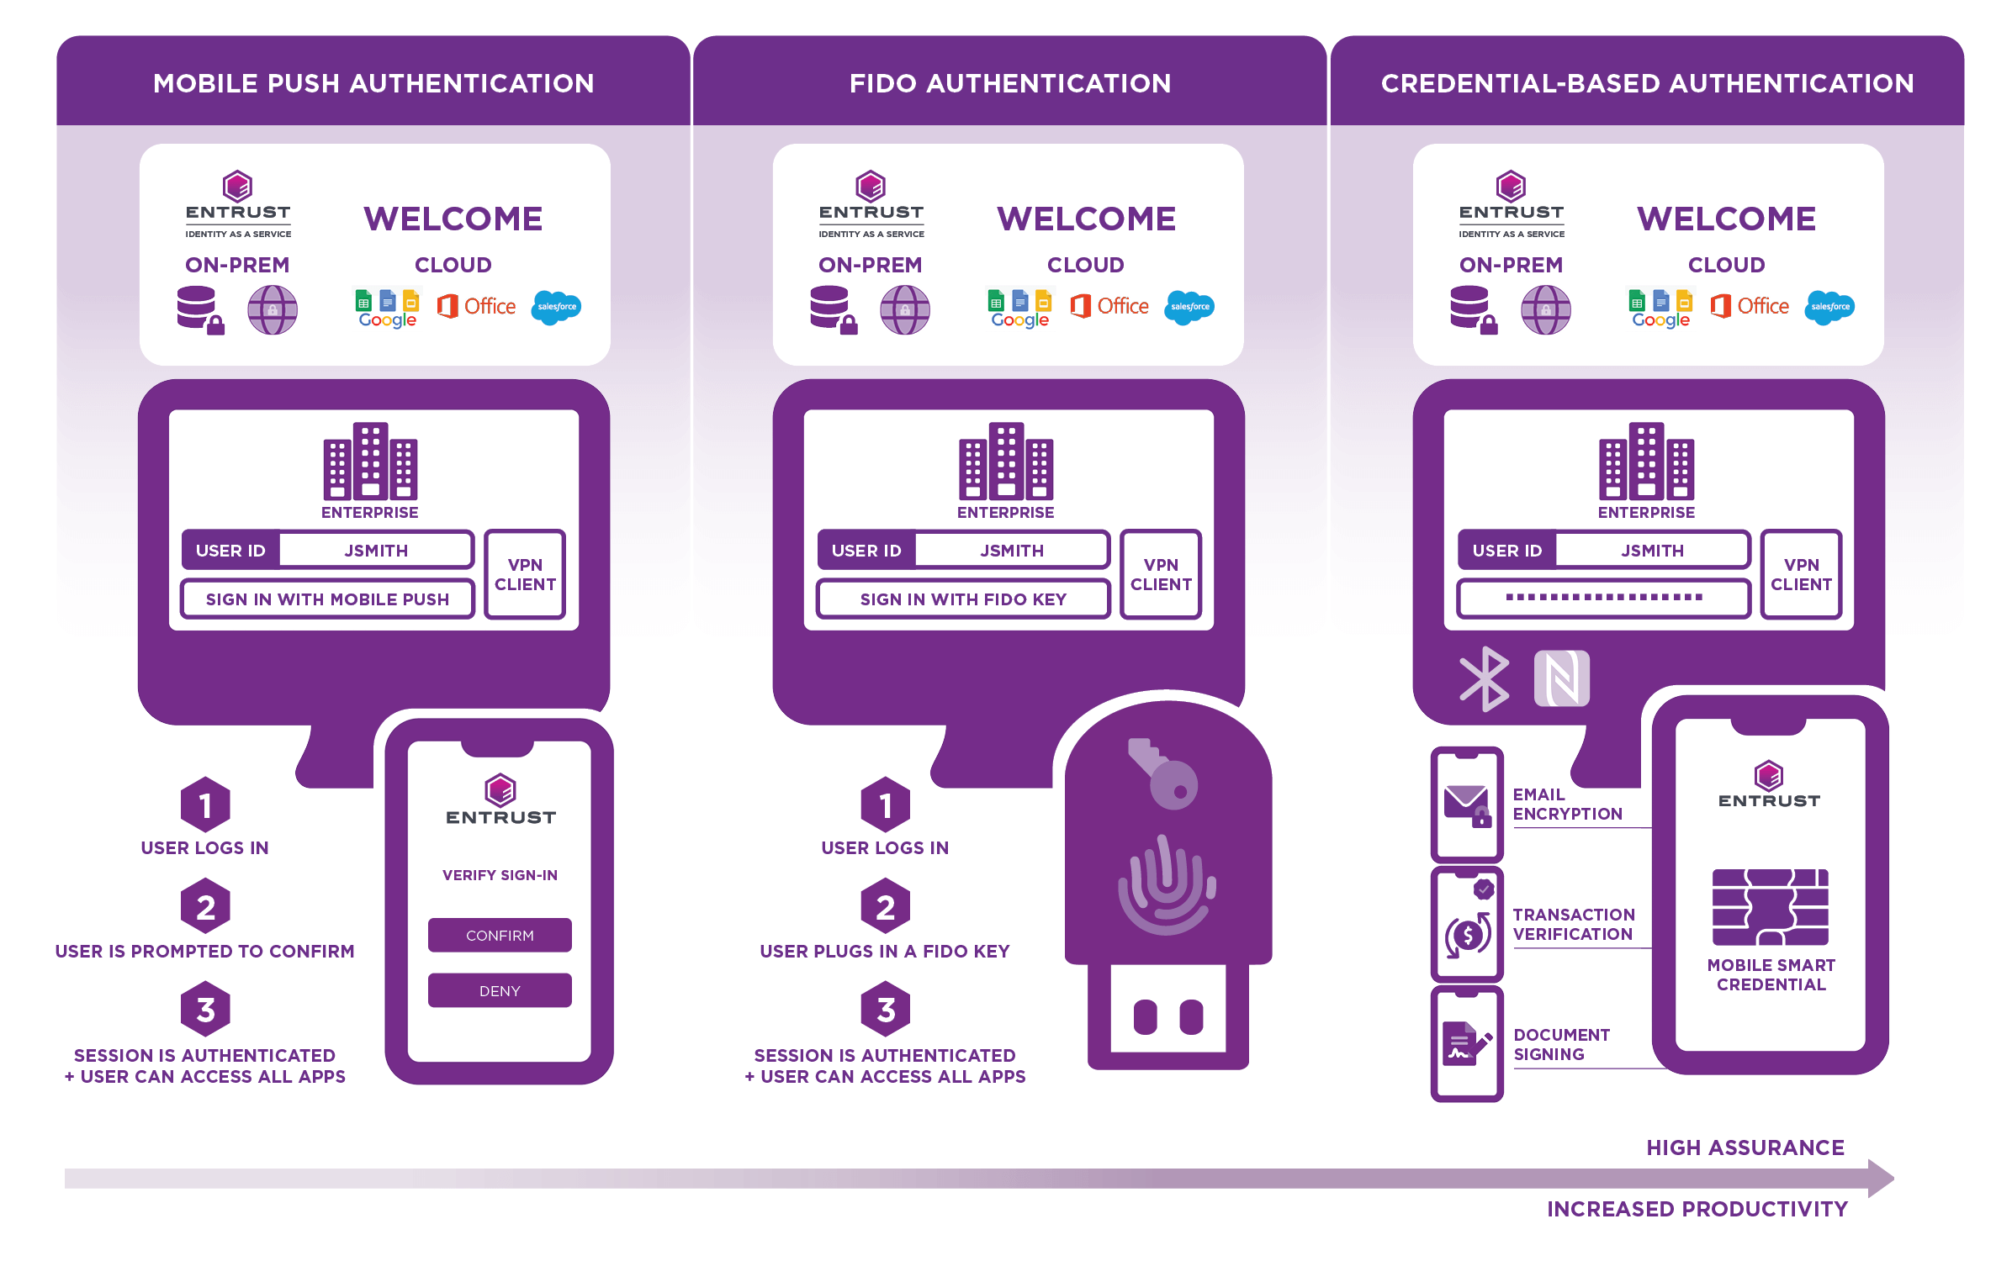
Advanced methods and the new challenges of authentication
Password-less authentication
The three most common types of password-free solutions are summarized in the illustrations below.[34]

Slide 56
Advanced methods and the new challenges of authentication
Password-less authentication
How does it work?
There are several methods of authentication without a password, but they all follow the principle of so-called “authentication factors”:
1. Something you know (such as a password) is replaced by :
2. Something you have (like a smartphone or a security key).
3. Something you are (like a fingerprint or other biometric attribute).
Here are some examples of passwordless methods:
- Biometric authentication: Using unique biological features such as fingerprint, facial recognition or iris to verify identity.
- One-time codes: Generation of a temporary code sent by SMS, email or via an authentication application.
- Hardware security keys: Use of devices such as YubiKey, which must be inserted into a USB port or connected via NFC to access an account.
- Magic links: Sending a link by e-mail which, once clicked, automatically authenticates the user.

Slide 57
Advanced methods and the new challenges of authentication
Password-less authentication
Adoption of Passwordless Technologies (FIDO2 and Cryptographic Keys):
What is FIDO2? FIDO2 (Fast Identity Online) is an open standard that eliminates passwords by using cryptographic keys for authentication. It involves two key components:
A private key stored on the user’s device (e.g., smartphone, hardware token).
A public key registered with the authentication server.
Authentication is achieved when the private key signs a challenge, which the server verifies using the public key.
Integration in Wireless Networks (Wi-Fi):
Passwordless authentication can be integrated into Wi-Fi security protocols like WPA3.
For example, WPA3-Enterprise uses 192-bit encryption and supports certificate-based authentication, reducing reliance on traditional passwords.
Cryptographic tokens or device-based authentication could simplify secure Wi-Fi access without requiring complex passwords.

Slide 58
Advanced methods and the new challenges of authentication
Password-less authentication
Passwordless Authentication in 5G Networks:
AKA Framework in 5G:
5G networks use the Authentication and Key Agreement (AKA) protocol to authenticate users and establish secure communication channels.
AKA relies on SIM/USIM credentials stored on the device to perform mutual authentication between the user and the network.
Passwordless Integration with AKA:
Passwordless methods, like FIDO2, can complement AKA by ensuring that the device and user are authenticated cryptographically without relying on passwords.
Example: A user’s biometric data (e.g., a fingerprint) could unlock the private cryptographic key stored in a secure element (like a Trusted Platform Module or eSIM). This key can then interact with the 5G network’s AKA system for seamless authentication.
Security Advantages:
Stronger resistance to phishing and credential theft since passwords are eliminated.
Enhanced user experience through faster, automatic, and secure connections.

Slide 59
Advanced methods and the new challenges of authentication
Password-less authentication
Benefits and Challenges:
Benefits:
Simplifies authentication by removing the need to remember or manage passwords.
Leverages strong cryptographic protocols to ensure security against attacks like brute-forcing or password sharing.
Challenges:
Compatibility: Requires devices, networks, and applications to support passwordless standards like FIDO2.
Deployment: Integrating cryptographic keys or biometric authentication into existing wireless and mobile infrastructures may require significant updates.
Privacy: Managing sensitive data (e.g., biometrics or private keys) securely is critical to avoid breaches.

Slide 60
Thanks for your attention!

Slide 61
REFERENCES
[1] course IOT M2 SETI, University Paris Saclay
[2]https://www.reddit.com/r/coolguides/comments/192cuy3/a_cool_guide_to_the_evolution_of_wifi_including
[3] https://cisco.goffinet.org/ccna/wlan/protocoles-securite-sans-fil-wpa-wpa2-wpa3
[4] https://community.iqoo.com/in/thread/27398
[5] https://reussirsonccna.fr/evolution-de-la-securite-wifi
[6] https://www.lemagit.fr/definition/WPA-Wi-Fi-Protected-Access
[7] https://ascentoptics.com/blog/fr/wep-wpa-wpa2-wpa3-classifying-and-comparing-wireless-protocols/#
[8] https://www.esecurityplanet.com/
[9] https://cisco.goffinet.org/ccna/wlan/protocoles-securite-sans-fil-wpa-wpa2-wpa3
[10] M. A. Abo-Soliman and M. A. Azer, "A study in WPA2 enterprise recent attacks," 2017 13th International Computer Engineering Conference (ICENCO), Cairo, Egypt, 2017, pp. 323-330, doi: 10.1109/ICENCO.2017.8289808. keywords: {Authentication;confidentiality;EAP;Network Access Control;wireless Security;Wi-Fi;WPA2},
[11] Mostafa, Ahmed. "What WPA3 Brings to Wi-Fi: Focus on SAE and OWE." CWNP, 2022, https://www.cwnp.com/uploads/what-wpa3-brings-to-wi-fi-focus-on-sae-and-owe-ahmed-mostafa-cwne-candidate-article-2022.pdf.
[12] Allied Telesis. (n.d.). 802.1X White Paper. Retrieved from https://www.alliedtelesis.com/sites/default/files/documents/white-papers/8021x_wp.pdf
[13] Huawei. (n.d.). Understanding WLAN Security Policies. Retrieved from https://support.huawei.com/enterprise/en/doc/EDOC1100096325/b27702df/understanding-wlan-security-policies
[14] Hwang, Y. Fall 2006 GPN 6 Final Report. George Mason University, 2006, https://cs.gmu.edu/~yhwang1/INFS612/Sample_Projects/Fall_06_GPN_6_Final_Report.pdf.

Slide 62
REFERENCES
[15] George Mason University. Fall 2006 GPN 6 Final Report. 2006, https://cs.gmu.edu/~yhwang1/INFS612/Sample_Projects/Fall_06_GPN_6_Final_Report.pdf.
[16] GL Communications Inc. GSM Network Protocol Analyzer. n.d., https://www.gl.com/gsm-network-protocol-analyzer.html.
[17] Nakarmi, P. K. (2021). Cheatsheets for Authentication and Key Agreements in 2G, 3G, 4G, and 5G. arXiv. Retrieved from https://arxiv.org/abs/2107.07416
[18] Xavier Lagrange, « Réseaux mobiles 2G et 3G : Caractéristiques d'une interface radio ». Département RSM, ENST Bretagne, 12/2004.
[19] Lee, A. J. B., Kim, E. H., Lee, K. W., Ko, Y. B., & Lee, H. S. (2014). Securing USIM-based mobile communications from interoperation of SIM-based communications. Proceedings of the 2014 International Conference on Information and Communication Security (ICICS), 7011579. Retrieved from https://www.researchgate.net/publication/265403245_Securing_USIM-based_Mobile_Communications_from_Interoperation_of_SIM-based_Communications
[20] Cichonski, J., Franklin, J. M., & Bartock, M. (2017). Guide to LTE Security. NIST Special Publication 800-187. National Institute of Standards and Technology. Disponible à l'adresse suivante : https://doi.org/10.6028/NIST.SP.800-187.
[21] Sanchez, Xavier, and Hamadou Thioune. UMTS. 2nd ed., Hermes, 2004. ISBN: 1-905209-71-1.
[22] Tech Junction. 4G LTE Network Security Procedures: Telecom Exam Questions and Answers. n.d., https://techjunction.co/4g-lte-network-security-procedures-telecom-exam-questions-and-answers/.
[23] Jeffrey Cichonski, Joshua M. Franklin, Michael Bartock « Guide to LTE Security. » December,2017.
[24] Orange Developer. "Généralités et architecture de la 4G." n.d., https://developer.orange.com/od-uploads/Generalites-et-architecture-de-la-4G.pdf.
[25] Bouguen, Yannick, Éric Hardouin, and François-Xavier Wolff. LT, E et les réseaux 4G. Eyrolles, 2012. ISBN: 978-2-212-12990-8.
[26] CableLabs. "A Comparative Introduction to 4G and 5G Authentication." CableLabs, n.d., https://www.cablelabs.com/insights/a-comparative-introduction-to-4g-and-5g-authentication.

Slide 63
REFERENCES
[27]Behrad, Shanay, Bertin, Emmanuel, Crespi, Noel. Securing Authentication for Mobile Networks, a Survey on 4G Issues and 5G Answers. 2018 International Conference on Intelligence in Next Generation Networks (ICIN), February 2018. DOI: 10.1109/ICIN.2018.8401619.
[28]Abdel-Malek, M. A., Sayed, M. M., & Azab, M. (2022). UAV-Based Privacy-Preserved Trustworthy Seamless Service Agility for NextG Cellular Networks. Sensors, 22(7), 2756. https://doi.org/10.3390/s22072756.
[29] M. Na et al., "Operator's Perspective on 6G: 6G Services, Vision, and Spectrum," in IEEE Communications Magazine, vol. 62, no. 8, pp. 178-184, August 2024, doi: 10.1109/MCOM.001.2400060. keywords: {6G mobile communication;Wireless communication;Wireless sensor networks;5G mobile communication;Extended reality;Standards organizations},
[30] Ericsson. (2020). 6G Security Drivers and Needs. Ericsson White Papers. Retrieved from https://www.ericsson.com/en/reports-and-papers/white-papers/6g-security-drivers-and-needs
[31] Thales Group. Identification et authentification biométrique. n.d., https://www.thalesgroup.com/fr/europe/france/dis/gouvernement/inspiration/biometrie#:~:text=Identification%20et%20authentification%20biom%C3%A9trique&text=L%27identification%20consiste%20%C3%A0%20d%C3%A9terminer,image%20de%20son%20empreinte%20digitale.
[32] Aratek – Biometric SIM Card Registration https://www.aratek.co/news/why-use-biometric-sim-card-registration
[33] Thales – Authentication sans mot de passe, https://cpl.thalesgroup.com/fr/access-management/authenticators/passwordless-authentication
[34] 4: Entrust – Authentication sans mot de passe https://www.entrust.com/fr/resources/learn/how-does-passwordless-authentication-work

Slide 64
ANNEXE
Explication détaillée des abréviations :
IMSI : International Mobile Subscriber Identity – Identifiant unique de l'abonné mobile dans le réseau.
RAND : Valeur aléatoire utilisée pour sécuriser le processus d'authentification.
AUTN : Authentication Token – Jeton contenant des informations de sécurité pour l'authentification (SQN, AK, AMF, MAC).
SQN : Sequence Number – Numéro de séquence utilisé pour éviter les attaques par répétition.
AK : Authentication Key – Clé utilisée pour l'authentification.
AMF : Authentication Management Field – Champ de gestion de l'authentification.
MAC : Message Authentication Code – Code pour vérifier l'intégrité des messages.
XMAC : Valeur calculée par l'UE pour comparer avec le MAC.
RES : Response – Réponse générée par l'UE.
XRES : Expected Response – Réponse attendue par le réseau, utilisée pour vérifier l'authentification.
CK : Cipher Key – Clé de chiffrement utilisée pour protéger les données échangées.

Slide 65
ANNEXE
TKIP (Temporal Key Integrity Protocol): A security protocol that incorporates additional mechanisms to address the issues encountered with WEP in practice.
Key mixing function: Combines a temporal secret key derived from the root secret key, an initialization vector, and the MAC address of the transmitter, then passes the result to RC4.
WEP limitation: WEP only concatenated the initialization vector with the key.
Sequence counter mechanism: Each sent packet includes a counter.
Packet rejection: Packets received out of order are discarded.
Michael: A Message Integrity Check (MIC) algorithm used to verify message integrity (64-bit).

Slide 66
ANNEXE
TKIP (Temporal Key Integrity Protocol): A security protocol that incorporates additional mechanisms to address the issues encountered with WEP in practice.
Key mixing function: Combines a temporal secret key derived from the root secret key, an initialization vector, and the MAC address of the transmitter, then passes the result to RC4.
WEP limitation: WEP only concatenated the initialization vector with the key.
Sequence counter mechanism: Each sent packet includes a counter.
Packet rejection: Packets received out of order are discarded.
Michael: A Message Integrity Check (MIC) algorithm used to verify message integrity (64-bit).

Slide 67
ANNEXE
l'attaque KRACK est une exploitation de faiblesse dans WPA2, ciblant spécifiquement le processus de négociation des clés, et nécessite des contre-mesures par des mises à jour ou des protocoles de sécurité supplémentaires.
PSTN (Public Switched Telephone Network), ou réseau téléphonique commuté public, est le réseau traditionnel utilisé pour les communications vocales filaires.
FDMA (Frequency Division Multiple Access) est une technique d'accès multiple utilisée dans les réseaux de communication pour permettre à plusieurs utilisateurs de partager une même ressource radio.

